Slide 1
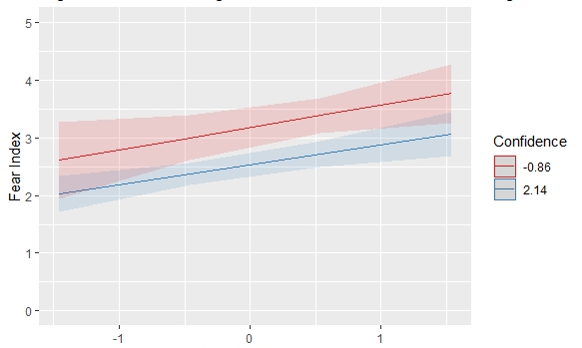
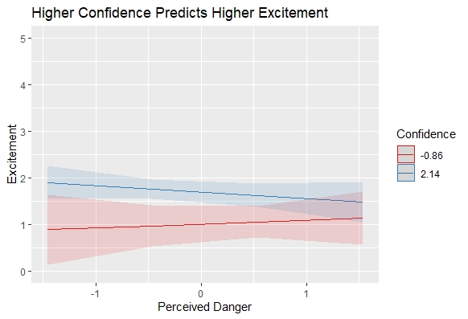
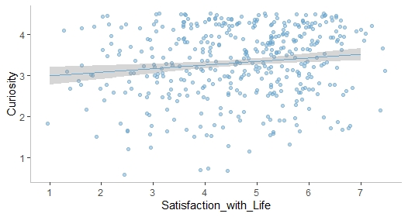
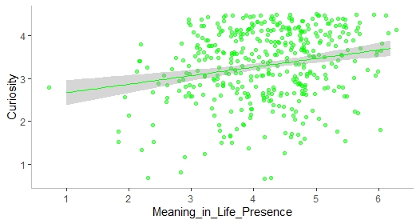
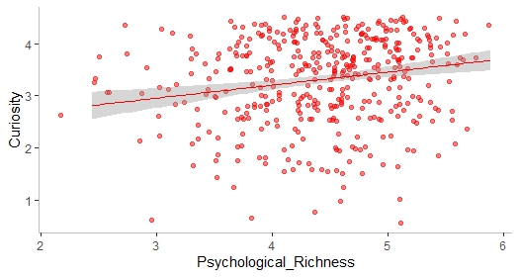
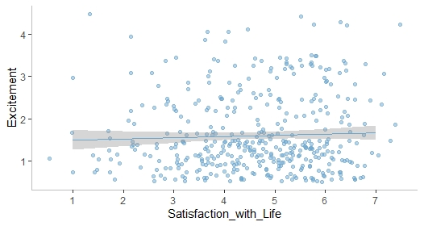
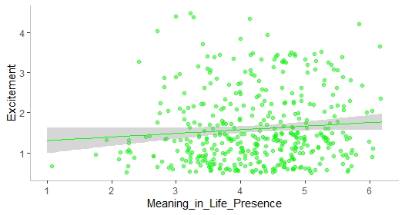
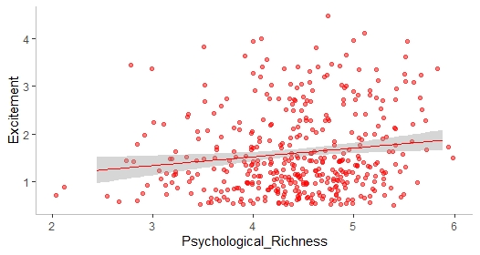
When Disasters are Exciting:
Fun vs Scary Perceptions of the Covid-19 Pandemic
Gaelle El Helou, Erin C. Westgate, Yijun Lin
Department of Psychology, University of Florida
Email: XXXXXXXXXX
Twitter: XXXXXX
Disasters
Study 1
Study 2
When we think of disasters, we usually think of negative outcomes and feelings. But some people (e.g., storm chasers!) seem to enjoy them.
Why do people get excited about disasters such as hurricanes and pandemics?
People were curious, somewhat scared, and a little excited about Covid-19
People who felt confident felt more excited, and less afraid. People who thought COVID-19 was dangerous felt more afraid.
Fear Index
Study 1: Well-being
Low
High
Who is excited about COVID-19?
515 international community volunteers
March – May 2020
IVs: Well-being
DVs: Curiosity & Excitement
Low
Danger
High
People with psychologically rich lives were more curious and excited about Covid-19
Danger: b =.39, p = <.001**, Confidence: b = -.21, p = .004**
Interaction: b = -.01, p = .86
Excitement
Study 2: Appraisals
People leading meaningful lives, b = .15, p = .005, and rich lives, b = .17, p = .009, were more curious about the coronavirus outbreak
Why are people excited – vs scared?
169 UF college students | Spring 2020
IVs: Perceived Danger + Confidence
DVs: Fear vs Excitement
Low
High
Fear Index → “How scared are you about the Coronavirus outbreak?” + “How anxious are you about the Coronavirus outbreak?”
Excitement → “How excited are you about the Coronavirus outbreak?”
Personal danger → “How potentially dangerous do you believe the Coronavirus is to you personally?
Confidence → “How confident are you that you will be able to handle an outbreak of the coronavirus?”
Low
High
Low
Danger
High
Satisfaction with Life
Meaning in Life
Psychological Richness
Danger: b = -.07, p = .39, Confidence: b = .22, p = .007**
Interaction: b = -.06, p = .41
People leading psychologically rich lives, b = .15, p = .005 were more excited about the coronavirus outbreak
Conclusion
People leading psychologically rich lives felt especially curious and excited about Covid19
Confidence → More excited, less afraid
Danger → More afraid
Satisfaction with Life
Meaning in Life
Psychological Richness

